Slide 1
Digital Image Processing DA Amil Anilkumar
Image Processing Using Multi-Code GAN Prior

Slide 2
Generative Adversarial Networks (GANs)
Machine learning models used for generating new data that is similar to some training data.
Consist of two neural networks
Generator: This network generates new data (e.g., images, text, or audio) that is intended to resemble real data.
Discriminator: This network evaluates the generated data to determine whether it looks real (similar to actual data) or fake (generated by the Generator)
Adversarial Training: The generator and discriminator engage in a competitive game, where the generator aims to fool the discriminator, and the discriminator aims to correctly identify real vs. fake data.
Objective: The goal of GANs is for the Generator to generate data that is as similar as possible to real data, to the point where the Discriminator cannot reliably tell the difference between the two.

Slide 3
Prerequisites Components
Pillow, Tqdm, numpy, torch, torchvision, pythontensorflow-gpu
Nvidia GPU, CUDA
Trained Models:
PGGAN and StyleGAN
Components
multi_code_inversion.py
colorization.py
face_semantic_editing.py
super_resolution.py
inpainting.py

Slide 4
PGGAN StyleGAN
Trained GAN Models
PGGAN
Progressive Growing of GANs
Used for face generation and image synthesis tasks
StyleGAN (Style Generative Adversarial Networks)
Used for high-quality image synthesis with control over style and content

Slide 5
Multi_code_Inversion_py
code processes input images
inverts them into latent codes using PGGAN
generates the closest possible reconstructions of the input images from those latent codes
goal is to reverse-engineer the image back into the latent space that the generator model uses to create it
C:\Users\kalai\Downloads\mganprior-master1\mganprior-master\multi_code_inversion.py

Slide 6
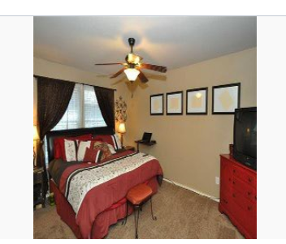
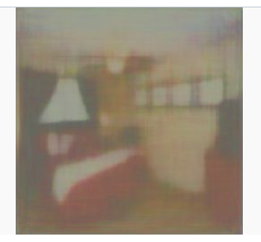
Example of Multi code Inversion
Input Image
output Image

Slide 7
Colorization.py
It takes grayscale images
inverts them into the latent space PGGAN
generates colorized versions of the input images in the YCbCr color space (to separate the luminance and chrominance channels
The final colorized image is saved in RGB format
C:\Users\kalai\Downloads\mganprior-master1\mganprior-master\colorization.py

Slide 8
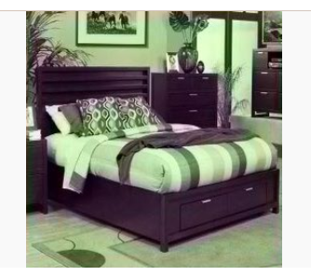
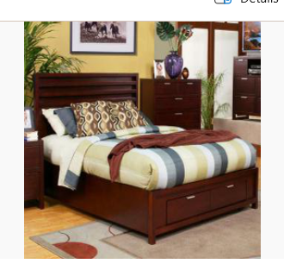
Example of Colorization
Output Image
Input Image

Slide 9
Inpainting
Given, a mask specifying the areas to inpaint
code processes input images
inverts them into latent codes using PGGAN
manipulation of their latent representations to perform inpainting (filling missing or masked parts of an image).
The code essentially reconstructs missing portions of an image based on its latent vector representation in the GAN model's space
C:\Users\kalai\Downloads\mganprior-master1\mganprior-master\inpainting.py

Slide 10
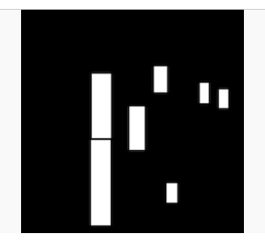
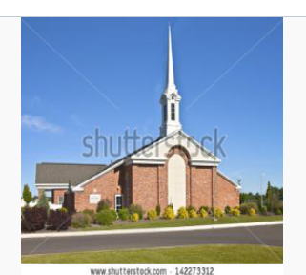
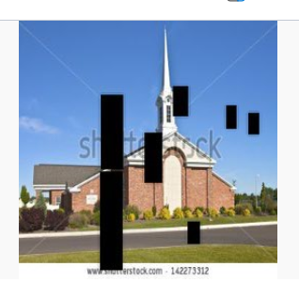
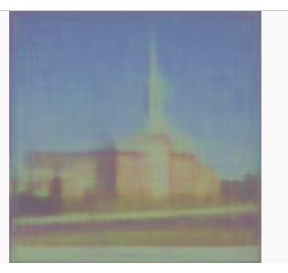
Example of inpainting
Mask
Given Image
Image with Mask
Output Image

Slide 11
Face semantic editing
Inverts target images to find their latent vector representations in the GAN's latent space.
manipulating attributes in the latent space
Attributes can be age, gender, expression, or pose
InterfaceGAN is used
C:\Users\kalai\Downloads\mganprior-master1\mganprior-master\face_semantic_editing.py

Slide 12
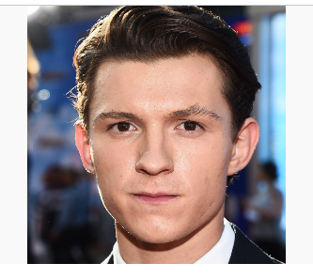
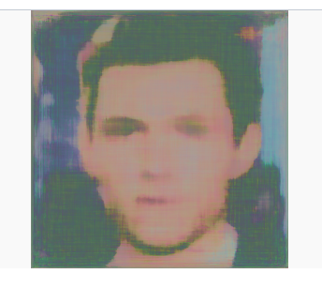
Example of face semantic editing
Given Image
Output Image

Slide 13
Super resolution
Used multi-code GAN prior by first inverting images into the GAN's latent space
generate high-resolution versions of those images
Super-Resolution Settings
Down - Specifies the downsampling method (e.g., bilinear)
Factor -SR factor (defines the upscaling factor).
Optimization Parameters
Optimization – specifies the optimization method( GD, Adam)
Lr – learning rate for optimization
C:\Users\kalai\Downloads\mganprior-master1\mganprior-master\super_resolution.py

Slide 14
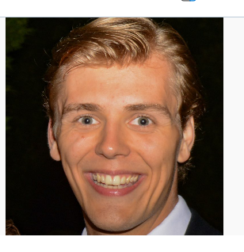
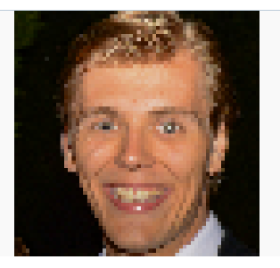
Example of Super Resolution
Input Image
Output Image

